Slide 1

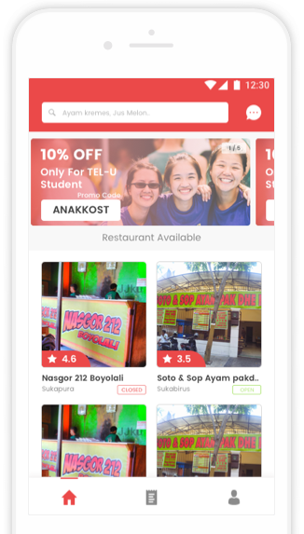
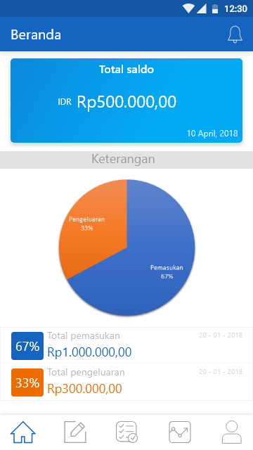
University
Accounting

Slide 2




Kelompok 9
Ryo Alif R
1301164351
Aup Hakim N
1301164395
Praditya Rizki N
1301164288
Rinaldy Achmad F
1301154357

Slide 3
1
Table of Content
1
2
3
4
2
3
4
System Overview
Usecase &
Class Diagram
Activity &
Sequence
ERD

Slide 4

1
1
System Overview
1
Modul transaksi belanja
2
Modul transaksi penerimaan
3
Modul transaksi posting
4
Modul transaksi laporan perbulan
5
Modul transaksi laporan pertahun

Slide 5






1
1
System Overview
Spesifikasi
Tools

Slide 6
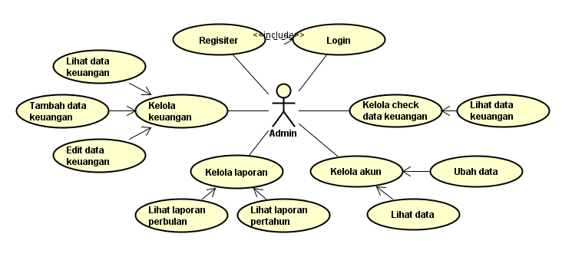
2
2
Use Case Diagram

Slide 7
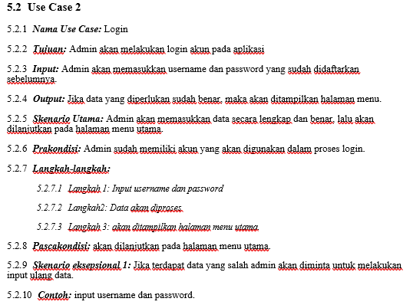
2
2
Use Case Scenario

Slide 8
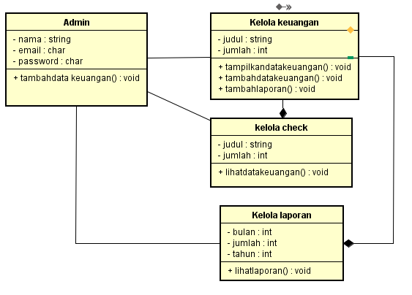
2
2
Class Diagram

Slide 9
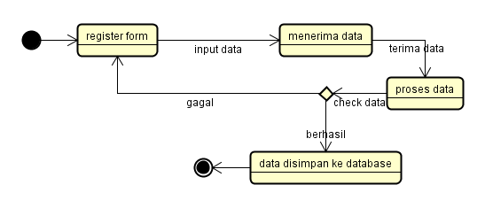
3
3
Activity Diagram

Slide 10
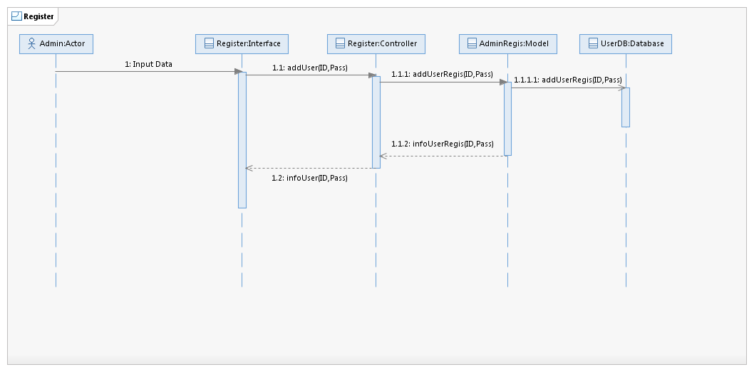
3
3
Sequence Diagram

Slide 11
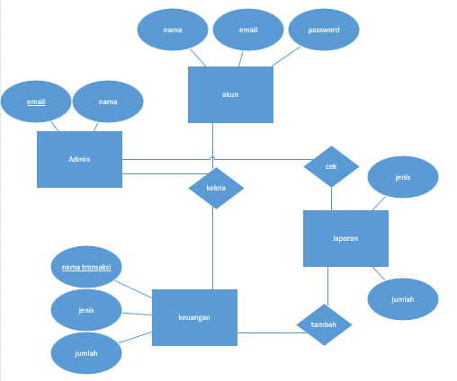
4
4
ERD

Slide 12
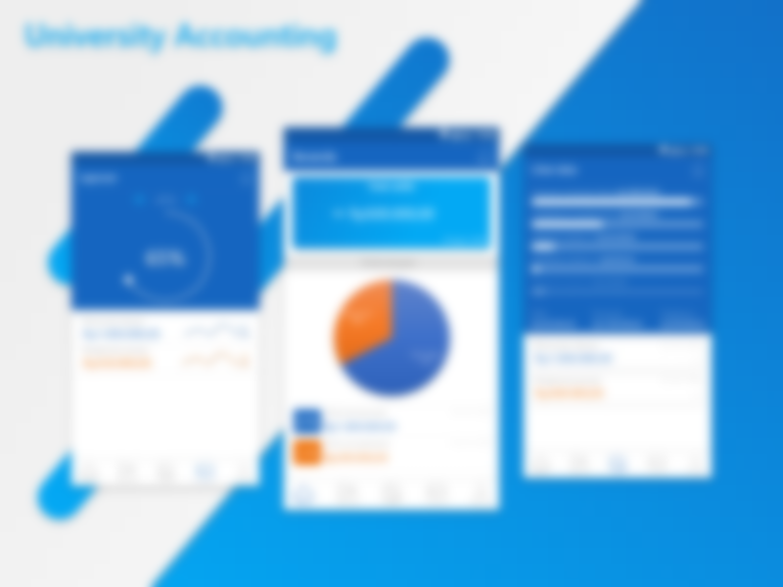

Link Prototype
gg.gg/ucount

